Slide 1
Chapter 3: Describing Data
BIOL201 WINTER 2020
Andrew M. Sackman, Ph.D.

Slide 2
How do we describe our data?
Descriptive statistics capture features of frequency distributions
We are specifically interested in the location and spread of a frequency distribution

Slide 3
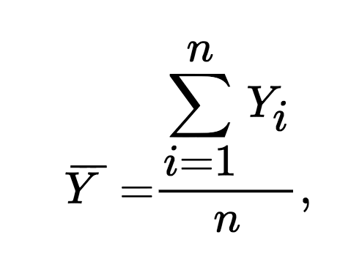
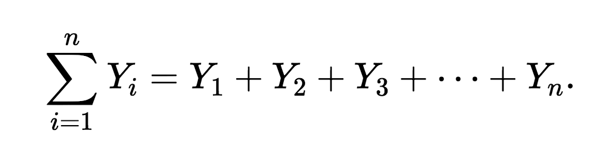
Measurements of location
The sample mean is the sum of all observations in a sample divided by n, the number of observations

Slide 4
Measurements of spread
The most common measure of spread is the standard deviation, which indicates how different measurements typically are from the mean
We calculate the standard deviation (s) from the variance (s²), another measure of spread
Both of these measurements are useful for different purposes

Slide 5
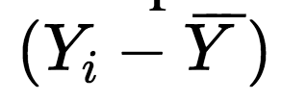
Calculating s and s²
First we calculate the deviations for our data
The deviation for each data point is just the difference between the measurement and the mean
The deviations should always sum to 0

Slide 6
Summing the deviations
Suppose we measure the mass of five frogs we find in a pond
Our sample is below
Sample Mass (g)
1 105
2 93
3 110
4 79
5 113
Our sample mean is:
105+93+110+79+113
5
=100

Slide 7
Summing the deviations
Suppose we measure the mass of five frogs we find in a pond
Our sample is below
_
Y=100
Sample Mass (g) Deviations (Y_{i}-Ȳ)
1 105 (105-100) = 5
2 93 (93-100) = -7
3 110 (110-100) = 10
4 79 (79-100) = -21
5 113 (113-100) = 13

Slide 8
Summing the deviations
Suppose we measure the mass of five frogs we find in a pond
Our sample is below
_
Y=100
Sample Mass (g) Deviations (Y_{i}-Ȳ)
1 105 (105-100) = 5
2 93 (93-100) = -7
3 110 (110-100) = 10
4 79 (79-100) = -21
5 113 (113-100) = 13
Sum of deviations = 0

Slide 9
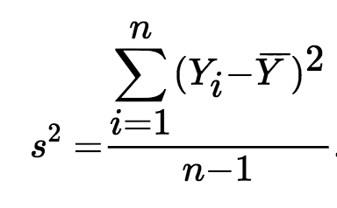
Calculating s and s²
Because the average deviation is 0, we average the squares of the deviations to get a measurement of spread. This also makes all of our values positive.

Slide 10
Summing the deviations
Suppose we measure the mass of five frogs we find in a pond
Our sample is below
_
Y=100
Sample Mass (g) Deviations (Y_{i}-Ȳ) Squares of deviations (Y_{i}-Ȳ)²
1 105 (105-100) = 5 5 * 5 = 25
2 93 (93-100) = -7 -7 * -7 = 49
3 110 (110-100) = 10 10 * 10 = 100
4 79 (79-100) = -21 -21 * -21 = 441
5 113 (113-100) = 13 13 * 13 = 169
Sum of squared deviations = 784

Slide 11
Calculating s and s²
Sum of squared deviations = 784
= 784/(5-1) = 784 / 4 = 196
The variance has units equal to the square of the original units of measurement
Also, note that we divide by n-1, not n

Slide 12
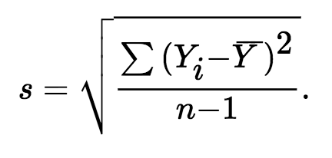
Calculating s and s²
The standard deviation has units equal to the original measurements
s² = 784/(5-1) = 784 / 4 = 196 s = sqrt(196) = 14

Slide 13
So what do s and s² mean?
Remember that this only holds true if the underlying distribution is normal

Slide 14
Quick note on rounding
When our mean is not a conveniently whole number, rounding errors at different steps in the statistical process can affect our final results
Always carry as many digits as possible during calculations, and if you are using R or a calculator, avoid rounding at intermediate steps

Slide 15
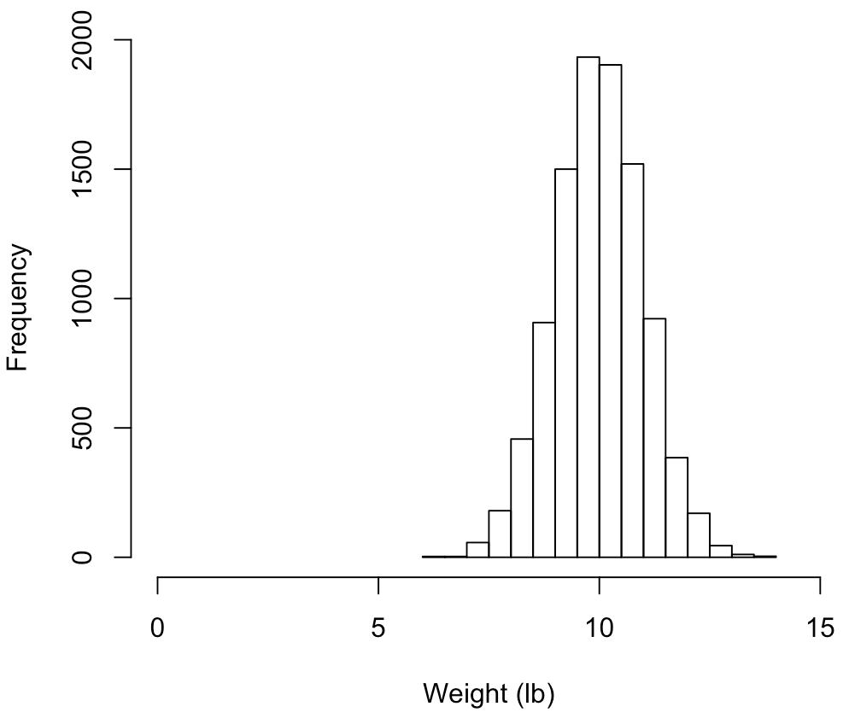
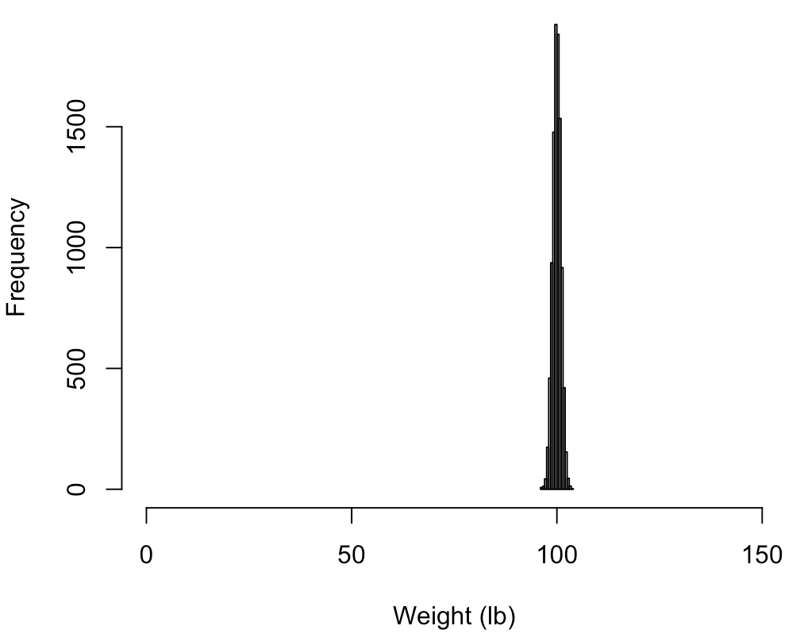
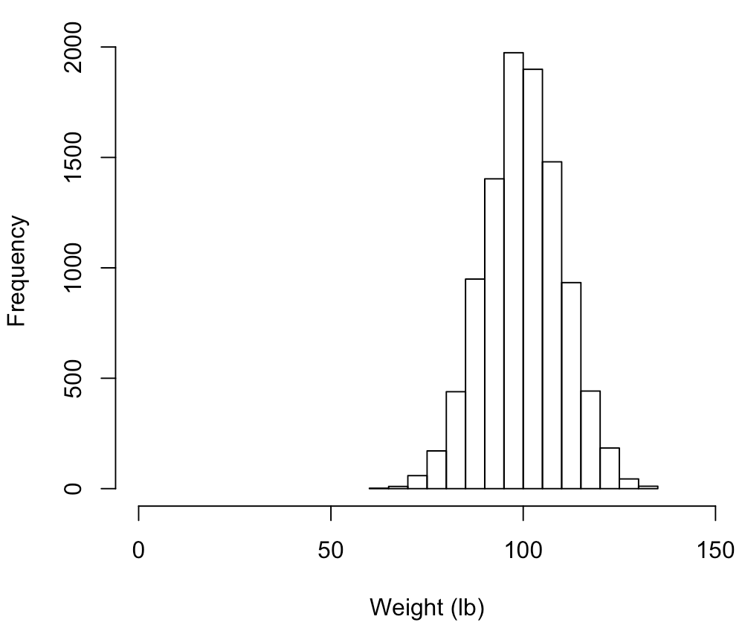
Coefficient of variation
Measures of spread can be meaningless without information on location
Suppose we are interested in the birth weights of African elephants and lowland gorillas

Slide 16
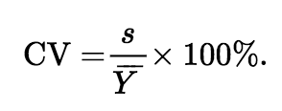
Coefficient of variation
The coefficient of variation is the standard deviation expressed as a percentage of the mean
s = 1 lb. CV = 10%
s = 1 lb. CV = 1%
s = 10 lb. CV = 10%

Slide 17
Coefficient of variation
We can also use the coefficient of variation to compare measurements in different units, i.e., is human height more variable than human mass?

Slide 18
Note on changing our measurement scales
Multiplying our measurements by a constant or adding a constant can change the mean and measures of variance

Slide 19
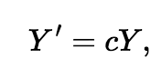
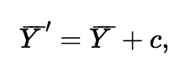
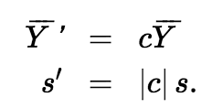
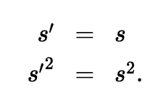
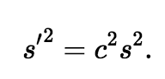
Note on changing our measurement scales
Multiplying our measurements by a constant or adding a constant can change the mean and measures of variance
Multiplying by a constant
Adding a constant

Slide 20
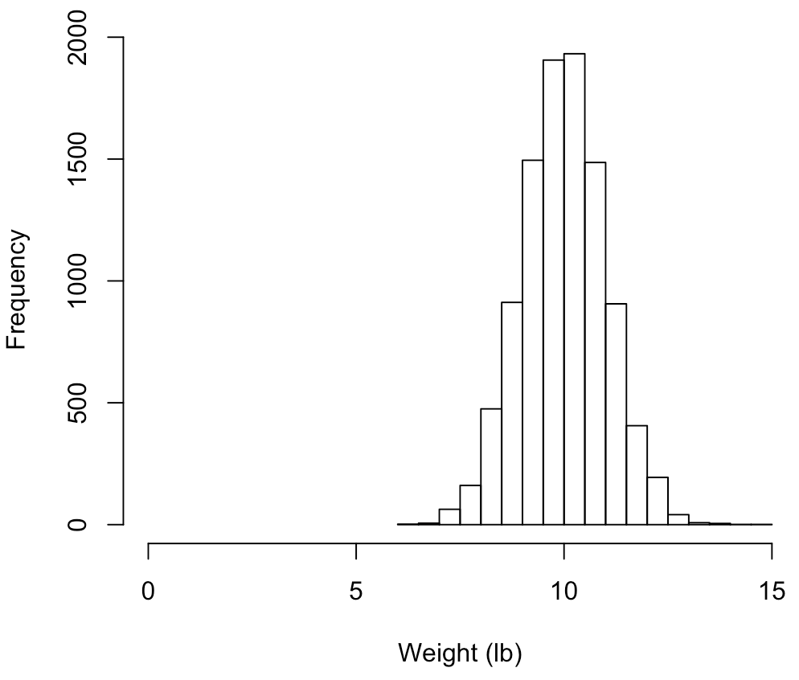
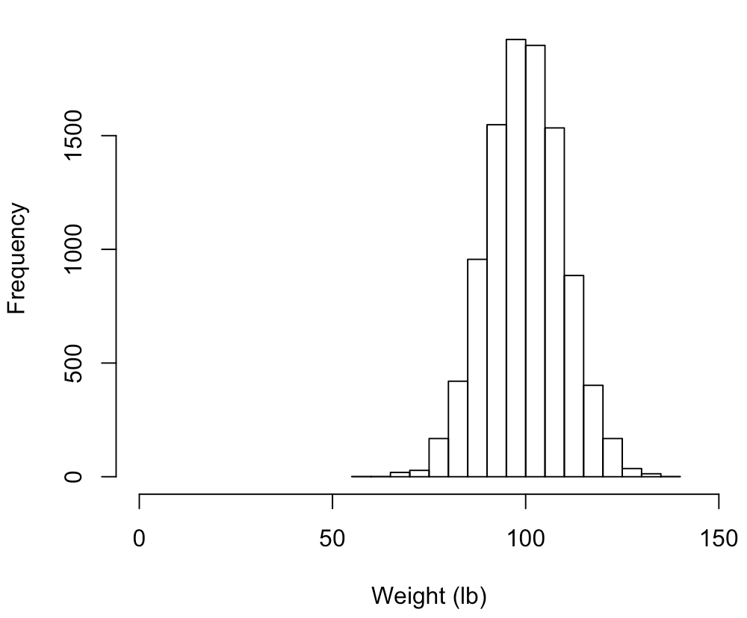
Note on changing our measurement scales
Multiplying our measurements by a constant or adding a constant can change the mean and measures of variance
Multiplying by a constant

Slide 21
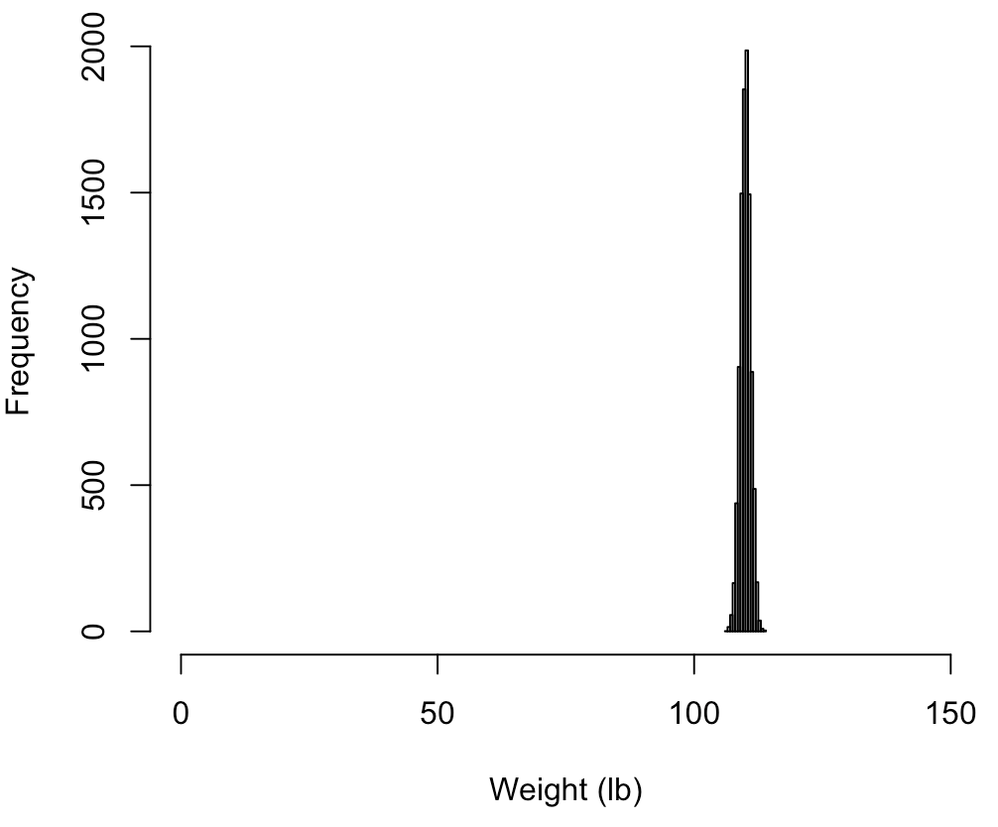
Note on changing our measurement scales
Multiplying our measurements by a constant or adding a constant can change the mean and measures of variance
Adding a constant

Slide 22
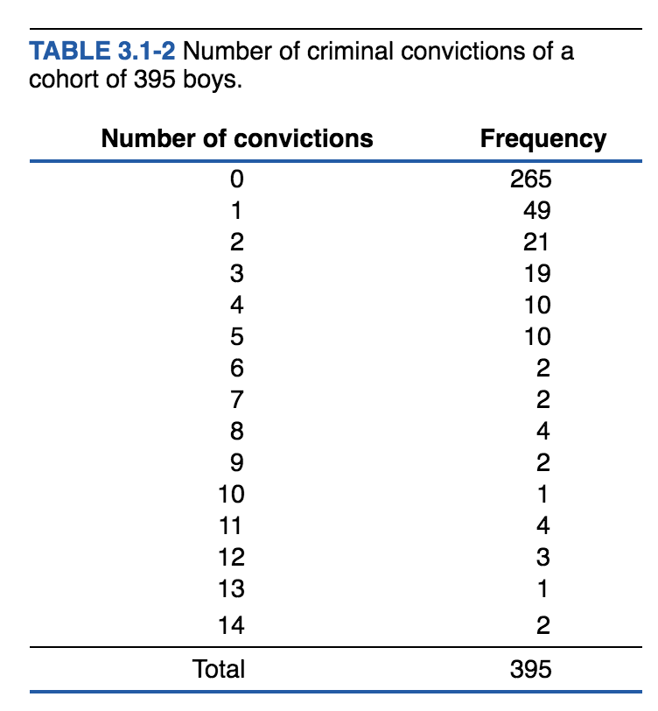
Calculating mean from a frequency table

Slide 23
Median
The median is the middle observation in a set of data sorted from smallest to largest
Sample Mass (g)
1 105
2 93
3 110
4 79
5 113
79, 93, 105, 110, 113
Median

Slide 24
Median
The median is the middle observation in a set of data sorted from smallest to largest
Sample Mass (g)
1 105
2 93
3 110
79
113
6 100
79, 93, 100, 105, 110, 113
Median = (100+105)/2 = 102.5

Slide 25
Interquartile range
First quartile, median, and third quartile mark the 25%, 50%, and 75% divides in our sorted sample. The interquartile range is the span of the middle 50% of our data.

Slide 26
Consider the box plot
Middle line = median
Bounds of box = 1st and 3rd quartile
Whiskers mark range of non-extreme values
Extreme values = more than 1.5x interquartile range from box edge

Slide 27
So which measures of spread and location are best?
To put it the way a parent might, one is not better than the other, they’re just different.
Both tell us something different about our data.

Slide 28
So which measures of spread and location are best?
Median and mean measure different aspects of the location of a distribution. The median is the middle value of the data, whereas the mean is its center of gravity.

Slide 29
So which measures of spread and location are best?
Median and mean measure different aspects of the location of a distribution. The median is the middle value of the data, whereas the mean is its center of gravity. So the mean is sensitive to extreme values.

Slide 30
So which measures of spread and location are best?
The mean is sensitive to extreme values.

Slide 31
So which measures of spread and location are best?
Because it is calculated from the square of the deviations, the standard deviation is even more sensitive to extreme observations than is the mean.
Interquartile range might give better information of spread.

Slide 32
Some more terminology
Medians and quartiles are examples of percentiles and quantiles
The percentile of a measurement specifies the percentage of observations less than or equal to it; the remaining observations exceed it. The quantile of a measurement specifies the fraction of observations less than or equal to it.

Slide 33
Yet another type of plot: The cumulative frequency distribution
Cumulative relative frequency at a given measurement is the fraction of observations less than or equal to that measurement.
Though less intuitive than a boxplot, the CDF conveys a lot of information, since every data point is represented.

Slide 34
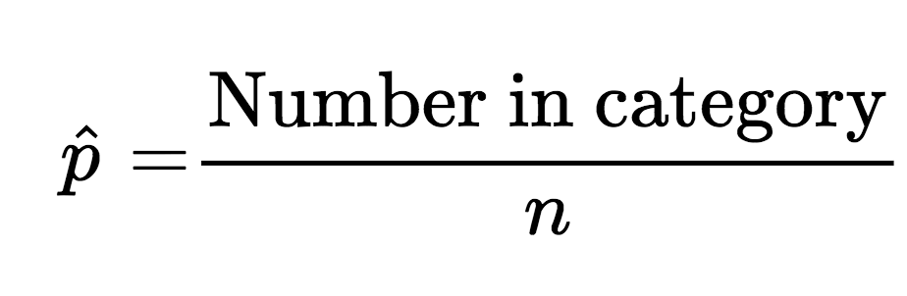
What about categorical variables?
For categorical variables (i.e., alive vs. dead, red vs. blue vs. green) we can use proportions, which are similar to a sample mean
The proportion of observations for a given category can be calculated as:

Slide 35
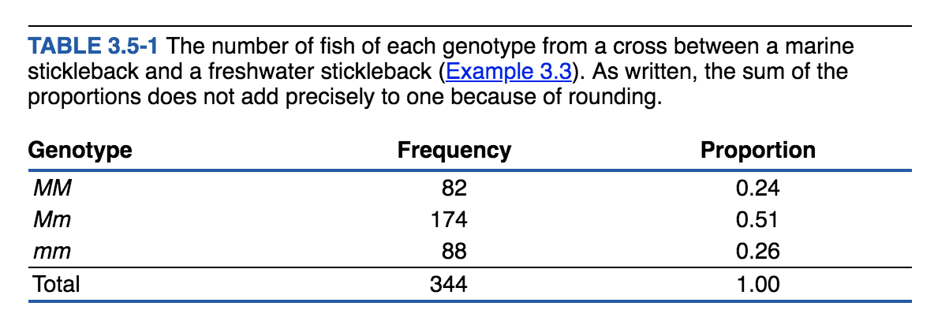
What about categorical variables?
The proportions across all categories should sum to 1 (assuming no rounding error)

Slide 36
pollev.com/sackman

Slide 37
Next class
Chapter 4: Measuring Uncertainty

Slide 38
Workshop time!

